Slide 1
Lecture-3 Parallel Processing Vs Pipelined Processing & Application of Parallel Processing

Slide 2
Pipelined Processing
There are many reasons that the entire execution of a machine instruction cannot happen at once;
in pipelining, effects that cannot happen at the same time are made into dependent steps of the instruction.
Number of steps
Instruction fetch.
Instruction decode and register fetch.
Execute.
Memory access.
Register write back.

Slide 3
Basic Ideas
Parallel processing
Pipelined processing
time
time
P1
P2
P3
P4
a1
a2
a3
a4
P1
P2
P3
P4
a1
b1
c1
d1
b1
b2
b3
b4
a2
b2
c2
d2
c1
c2
c3
c4
a3
b3
c3
d3
d1
d2
d3
d4
a4
b4
c4
d4
Less inter-processor communication
Complicated processor hardware
More inter-processor communication
Simpler processor hardware
Colors: different types of operations performed
a, b, c, d: different data streams processed

Slide 4
Data Dependence
Parallel processing requires NO data dependence between processors
Pipelined processing will involve inter-processor communication
P1
P2
P3
P4
P1
P2
P3
P4
time
time

Slide 5
Usage of Pipelined Processing
By inserting latches or registers between combinational logic circuits, the critical path can be shortened.
Consequence:
reduce clock cycle time,
increase clock frequency.
Suitable for DSP applications that have (infinity) long data stream.
Method to incorporate pipelining: Cut-set retiming
Cut set:
A cut set is a set of edges of a graph. If these edges are removed from the original graph, the remaining graph will become two separate graphs.
Retiming:
The timing of an algorithm is re-adjusted while keeping the partial ordering of execution unchanged so that the results correct
Notes:
Applications of DSP (Digital Signal Processing) include audio signal processing, audio compression, digital image processing, video compression, speech processing, speech recognition, digital communications, digital synthesizers, radar, sonar, financial signal processing, seismology and biomedicine.

Slide 6
Application of Parallel Processing

Slide 7
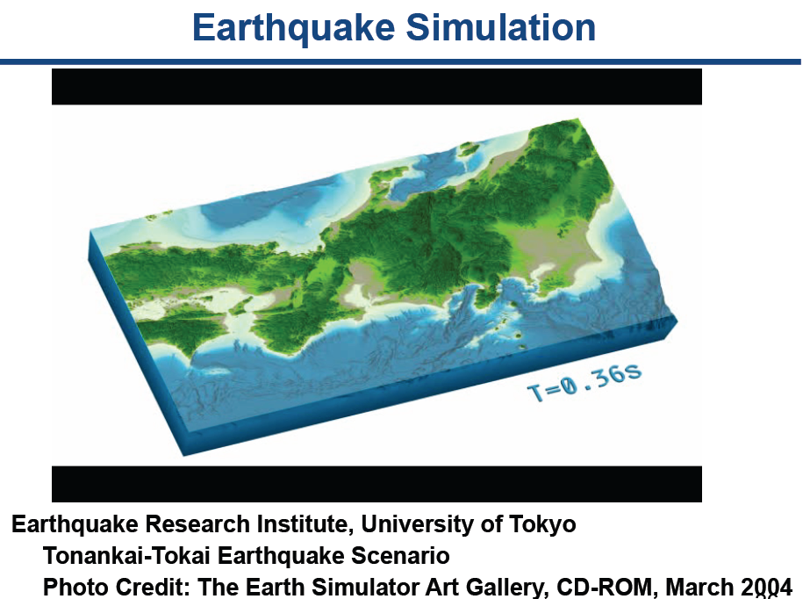

Slide 8
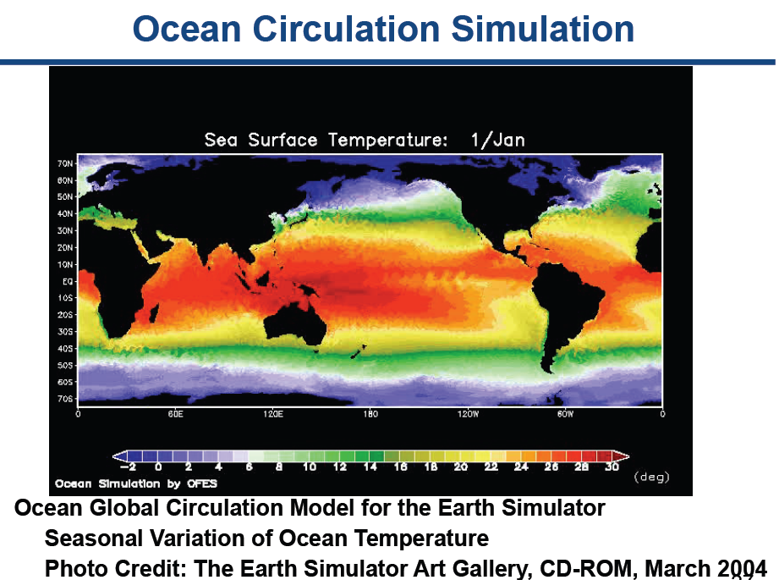

Slide 9
Numeric Weather Prediction
NWP uses mathematical models of atmosphere and oceans. Taking current observations of weather and processing these data with computer models to forecast the future state of weather. Uses data assimilation to produce outputs

Slide 10
Oceanography and Astrophysics
Used to study wealth of ocean using multiprocessors having large computational power with low power requirements. ROMS were used originally but now MPI programming methods are used. Computational astrophysics refers to the methods and computing tools developed and used in astrophysics research. PIC (Particle-in-Cell) ,PM (Particle-Mesh) and n-body simulations are different important techniques for computational astrophysics.

Slide 11
Socio Economics
Parallel processing is used for modeling of a economy of a nation/ world. Programs system which involves cluster computing device to implement parallel algorithms of scenario calculations ,optimization are used in such economic models. Such program system serves for conducting multi-scenario calculations to design a suitable development strategy for a region.

Slide 12
Finite element analysis
FEA is a numeric method commonly used for multi physics problem. Used in design of huge structures like ships, dams, supersonic jets etc. In FEA extremely large amount of partial differential equations are to solved concurrently and hence parallel processing elements are used.

Slide 13
Artificial Intelligence and Automation
AI is the intelligence exhibited by machines or software. AI systems requires large amount of parallel computing for which they are used. Four types :
1.Image processing
2.Expert Systems
3.Natural Language Processing(NLP)
4.Pattern Recognition

Slide 14
Seismic Exploration
It is a method of exploration that uses the principles of seismology to estimate the properties of the Earth's subsurface from reflected seismic waves. When a seismic wave travelling through the Earth encounters an interface between two materials, some of the wave energy will reflect off the interface which are analyzed to determine underground strata. Such large number of reflected waves are analyzed using sensors and parallel architecture

Slide 15
Genetic Engineering
It is the direct manipulation of an organism's genome using biotechnology for eg. DNA sequence analysis. Several of these analysis produce huge amounts of information which becomes difficult to handle using single processing units because of which parallel processing algorithms are used.

Slide 16
Weapon Research and Defense
Computer clusters are used in simulations that show a nuclear weapon's performance in precise molecular detail, tools that are used for national defense.
Parallel computing is required which are needed to more efficiently certify nuclear weapons, to accurately show molecular-scale reactions taking place over milliseconds, or thousands of a second. They are also used in plutonium research to study its behavior under high pressure whose alloys are then used for making explosives .

Slide 17
Medical Applications
Parallel computing is used in medical image processing Used for scanning human body and scanning human brain Used in MRI reconstruction Used for vertebra detection and segmentation in X-ray images Used for brain fiber tracking .

Slide 18
Remote Sensing Applications
It is a software application that processes remote sensing data. Remote sensing applications read specialized file formats that contain sensor image data, geo referencing information, and sensor metadata. Computer analysis of such remotely sensed earth resources data has many applications in agriculture, forestry etc. Explosive amounts of pictorial information needs to be processed in this area.

Slide 19
Energy Resource Exploration
Resource Exploration is a method to gather and manage information about energy resources like oil, natural gas etc. Computers here help in the discovery and management of such energy resources. This sector maintains the records of global energy crisis and also helps in ensuring nuclear reactor safety.

Slide 20
Thank You

